Slide 1


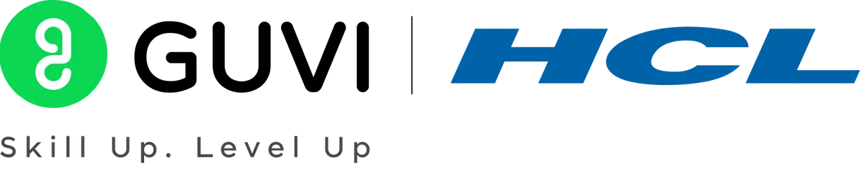

GUVI - Naan Mudhalvan
Engineering Hackathon 2025
www.guvi.in

Slide 2
Learning Programs
HEALTHCARE IMAGING – TUMOR DETECTION SYSTEM
Team name:NMGK02
Team members:
Balaji
Nadesh
Weslin Samuel
Jenifa
Sherine
Lydia
Jabisha
www.guvi.in

Slide 3
AGENDA
Introduction
Problem Statement and its Objectives
Techniques Used
Challenges and Benefits
Future Enhancements
Sample Input and Output
Conclusion
Learning Programs
www.guvi.in

Slide 4
Introduction
Learning Programs
A Healthcare Imaging Tumor Detection System is a smart medical tool that uses imaging techniques and artificial intelligence (AI) to find and study tumors in the body. It helps doctors and radiologists detect cancer early and more accurately, making diagnosis faster and more reliable.
www.guvi.in

Slide 5
Problem Statement
Learning Programs
Healthcare professionals spend countless hours manually analyzing medical scans like MRIS for anomalies. Subtle patterns may get overlooked, delaying diagnosis. A vision-based solution that detects tumor-like anomalies by analyzing intensity, texture, and shape patterns in medical images is necessary to improve patient outcomes.
Objective
To identify and highlights the tumor region in medical images.
www.guvi.in

Slide 6
Techniques Used
Learning Programs
i) CNN:
CNN is a Convolutional Neural Network.
It is a type of artificial intelligence that helps computers understand images by learning patterns like shapes, edges, and colors.
ii) Canny Edge Detection:
It is a method used to find the edges or outlines of objects in an image
It helps highlight important boundaries by removing noise and detecting sharp changes in brightness.
iii) Otsu:
It is a way to automatically choose the best threshold to turn a gray image into black and white.
It separates objects from the background by finding the point where the difference between them is the clearest.
www.guvi.in

Slide 7
Challenges
Integration with Hospital Systems: Needs to work smoothly with existing software which can be technically complex.
False Positives/Negatives: Sometimes the system may wrongly detect or miss a tumor, which can affect diagnosis.
Learning Programs
Benefits
Reduced workload for doctors: Supports radiologists by handling repetitive tasks, allowing them to focus on complex cases.
High accuracy: AI systems can detect small or hidden tumors more accurately than the human eye.
www.guvi.in

Slide 8
Future Enhancements
Learning Programs
3D tumour Visualization: Create 3D models of tumors from multiple scan slices to assist with surgery planning and treatment decisions.
Integration with Robotic surgery and Biopsy: Use tumor detection data to guide robotic systems during operations or needle biopsies with higher precision.
Multimodal Imaging Analysis: Combine data from different imaging techniques for more comprehensive tumor detection.
www.guvi.in

Slide 9
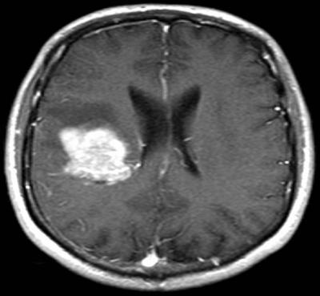
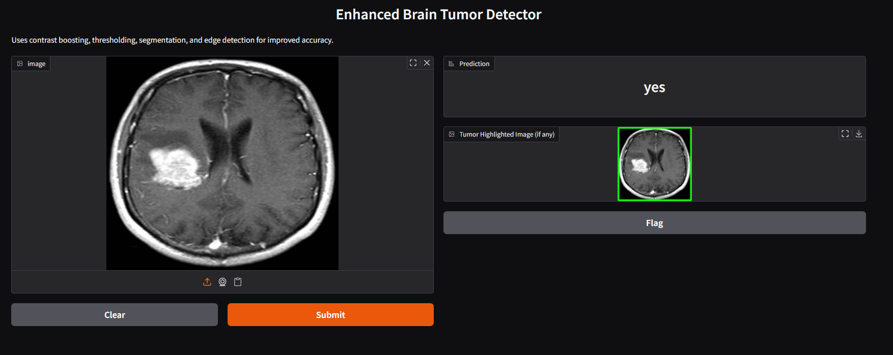
Sample Input and Output
Learning Programs
Fig. Input
Fig. Output
www.guvi.in

Slide 10
Learning Programs
Conclusion
The healthcare imaging tumour detection system uses AI and image processing to help doctors detect tumors early and accurately, improving diagnosis, reducing errors, and supporting better patient care.
www.guvi.in

Slide 11
Thank You
www.guvi.in

